Slide 1
Running Windows 10 on Raspberry Pi

Slide 2
Overview
Introduction to the Raspberry Pi device
Getting Windows 10 onto a Raspberry Pi
Deploying C# applications
Raspberry Pi and Snaps
Q & A

Slide 3
Raspberry Pi Introduction

Slide 4
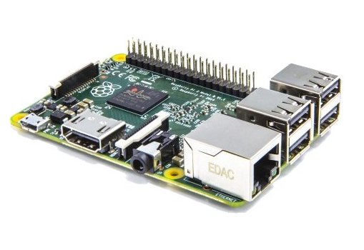
What is the Raspberry Pi?
The Raspberry Pi is a small computer system built onto a tiny circuit board
It has around the same computing power as a modern Smartphone
You can use various operating systems, including Windows 10

Slide 5
What do I need to get started?
You can buy a Pi for a very low price, but remember that you will need at least a case, keyboard, mouse, screen and power supply as well
You can use the ones from your PC if you like
The keyboard and the mouse must be USB
The monitor must be HDMI (you can use composite but the quality is not very good)
You will need a USB power supply and a micro-usb cable
The Raspberry Pi can be a bit picky about some devices
Best to seek out ones sold to work with the Pi

Slide 6
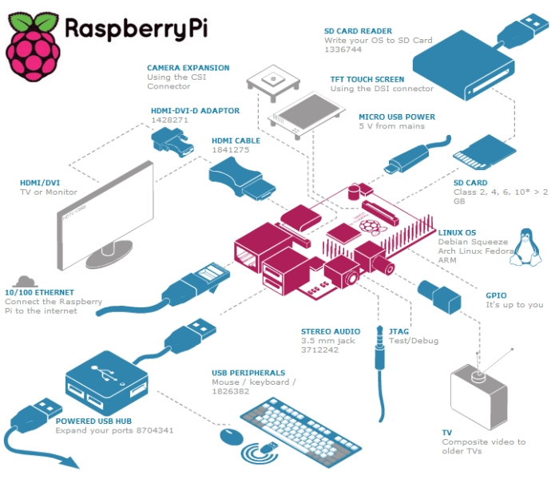
What can I connect a Raspberry Pi to?
There are lots of connection options:
USB peripherals
HDMI monitor
Wired network
Stereo Audio
You can use input/output pins to link to electrical components

Slide 7
Flavours of Pi for Windows 10
There have been a number of different versions of Raspberry Pi over the years
For the Windows 10 operating system you need Version 2.0 of the platform
This has a quad core processor and more memory than the original device

Slide 8
Windows 10 on Pi
What you don’t get is a multi-purpose device that you can use to replace your desktop PC
Instead you get a device that can load and run a single Windows 10 Universal Application

Slide 9
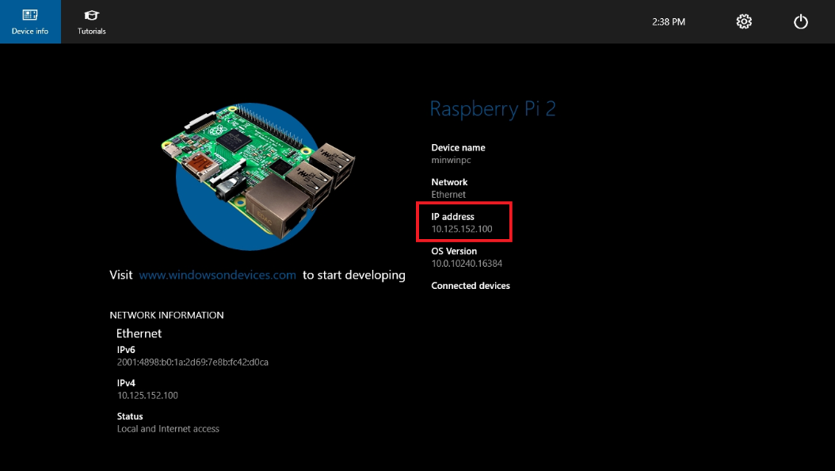
Windows 10 desktop
This is the display you get when Windows 10 boots

Slide 10
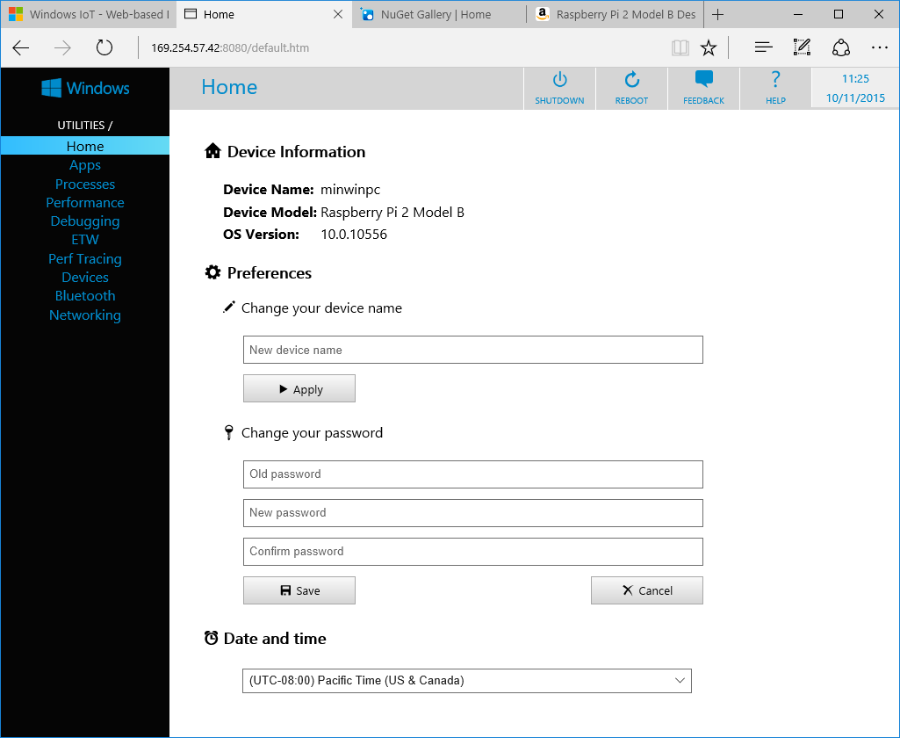
Windows 10 Web Management
You can also manage it via a web connection

Slide 11
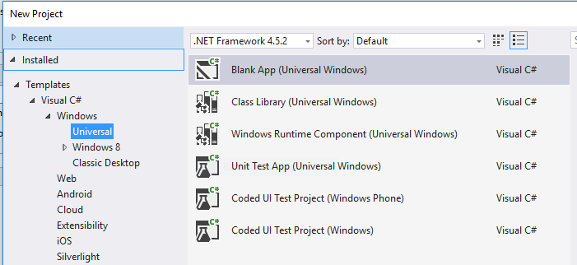
Windows 10 and Universal apps
Modern Windows 10 apps can be made “Universal”
A single app can run on a variety of platforms

Slide 12
Deploying to a Raspberry Pi
To deploy a universal application to a Raspberry Pi you just have to set the type to ARM and the target to be the remote machine

Slide 13
Deploying to a Raspberry Pi
To deploy a universal application to a Raspberry Pi you just have to set the type to ARM and the target to be the remote machine

Slide 14
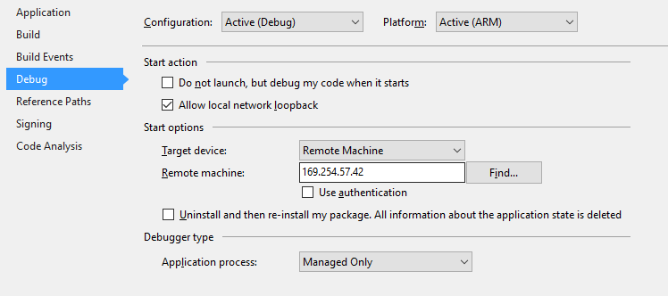
Finding the Pi
You can set the ip address and authentication to use

Slide 15
Talking to Hardware
You can just run XAML windows applications on the Pi if you like
But you can also talk to the hardware
There are object based abstractions for GPIO pins etc
There is now a high performance library as well

Slide 16
Demo
Build and deploy a new project
Show the Snaps framework running on Raspberry Pi
…and the LogoBlaster

Slide 17
Questions

Slide 18
Links
www.raspberrypi.org
https://dev.windows.com/en-us/iot

