Slide 1
File Handing and Debugging
Wrestling with Python
Classes

Slide 2
File Handing and Debugging
Storing data in files
PyScripter – an improvement on IDLE
Principles of Debugging
The Art of Programming

Slide 3
File Input/Output

Slide 4
Persisting Data
At the moment the data in our programs is discarded when we exit the Python system
Programs need a way of persisting data
Python can store data using the file system of the computer
This also means that Python programs can share data with other programs

Slide 5
Writing into a file
f=open('Fred.txt',mode='w')
f.write('Line 1\n')
f.write('Line 2')
f.close()
These four lines of text create a file that contains two lines:
Line 1
Line 2

Slide 6
Writing into a file
f=open('Fred.txt',mode='w')
f.write('Line 1\n')
f.write('Line 2')
f.close()
These four lines of text create a file that contains two lines:
The variable f refers to a “file stream” that connects the program to a file
Line 1
Line 2

Slide 7
Writing into a file
f=open('Fred.txt',mode='w')
f.write('Line 1\n')
f.write('Line 2')
f.close()
These four lines of text create a file that contains two lines:
The file is called ‘Fred.txt’
Line 1
Line 2

Slide 8
Writing into a file
f=open('Fred.txt',mode='w')
f.write('Line 1\n')
f.write('Line 2')
f.close()
These four lines of text create a file that contains two lines:
This is the filename which includes a language extension marking the file as text
Line 1
Line 2

Slide 9
Writing into a file
f=open('Fred.txt',mode='w')
f.write('Line 1\n')
f.write('Line 2')
f.close()
These four lines of text create a file that contains two lines:
This request that the file be opened for writing – r would mean reading
Line 1
Line 2

Slide 10
Writing into a file
f=open('Fred.txt',mode='w')
f.write('Line 1\n')
f.write('Line 2')
f.close()
These four lines of text create a file that contains two lines:
This character sequence means “Take a New Line” here
Line 1
Line 2

Slide 11
Writing into a file
f=open('Fred.txt',mode='w')
f.write('Line 1\n')
f.write('Line 2')
f.close()
It is very important that the file is closed when the writing has finished
This is the point at which the text is actually written into the file

Slide 12
File Write Location
If you just give the name of the file it will be created in the location where the program is running
This will might be a Python system directory
Your files will be very hard to find on the system

Slide 13
Where files are stored
The files are stored in different places depending on the system you are using
Different computers have different places where the files are stored
PCs and Macs store files in different ways
This also depends on how the PC is configured
Some systems will store files on the network

Slide 14
The File Path
f=open('C:/users/rob/test.txt',mode='w')
The file path is a string of text that specifies where on the system the file is located
This would put a file called test.txt in the folder for user rob

Slide 15
The Drive letter
f=open('C:/users/rob/test.txt',mode='w')
This specifies the drive where the file is to be stored
The drive is specified by a letter
Drive c: is usually the main storage device in your computer
Other disks may have different letters

Slide 16
The File Path separator
f=open('C:/users/rob/test.txt',mode='w')
The / character separates each of the folders in the path to this file
In Windows there is a folder that holds another folder for each user of the system
The separator is different for systems

Slide 17
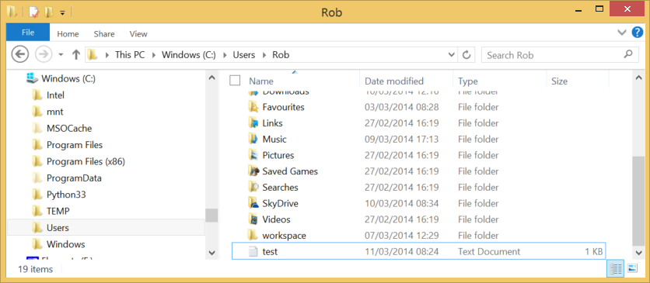
The Files on the Disk
This is where the file ends up in my home directory

Slide 18
Reading from a file
f=open('Fred.txt',mode='r')
line = f.readline()
print(line)
f.close()
A file can be opened in read mode
Each call of readline will fetch the next line of the file
Again, you should close the file when finished

Slide 19
Detecting the end a file
x = f.readline()
if len(x) == 0:
print('End of file')
A program can detect when the end of a file has been reached by checking for a line length of zero
An empty line in a file will have a length of 1, the linefeed character

Slide 20
Reading all the lines a file
f=open('Fred.txt',mode='r')
for line in f:
print(line)
A file can be used as the source of a for loop iteration
The content of the loop will then be performed for each of the lines in the file

Slide 21
Line endings
>>> f=open('Fred.txt',mode='r')
>>> a = f.readline()
>>> a
'Line 1\n'
When you read a line from a file you will get the line ending character in the string
This can cause problems with printing as you will get a blank line after each line

Slide 22
Stripping
>>> a = a.strip()
>>> a
'Line 1'
All string variables provide some methods that can act on them and return the result
The strip method removes non-printing characters from the start and the end of a string

Slide 23
Writing Numbers
score = 6
f.write(str(score))
When we write a number value to a file it must be converted into a string before it can be written
When the value is read back the program will have to use the int function to convert the string back into a value

Slide 24
Reading and writing etiquette
There are methods that you can use to move around a large file
You can move to the end of a file and write extra items on the end
If you write over a file it is overwritten with no confirmation of the action
File activities can cause exceptions which will crash your program

Slide 25
Practical Break 1
Using Files

Slide 26
Class Design Question
Who is responsible for saving a player to a file and reading it back?

Slide 27
Class Design Question
Who is responsible for saving a player to a file and reading it back?
The player should do this
You could add a save method that accepts a file stream
You could add a constructor that accepts a file stream and creates an object from it

Slide 28
The PyscriptEr program

Slide 29
Debugging in Idle
Traceback (most recent call last):
File "C:/Users/Rob/SkyDrive/Wrestling with Python/Season 2/Week 06 File Handing and Debugging/FileSave.py", line 58, in <module>
if len(x) == o:
NameError: name 'o' is not defined
The debugging in IDLE is not very useful
Although we can work out from the message where things went wrong

Slide 30
Debugging in Idle
Traceback (most recent call last):
File "C:/Users/Rob/SkyDrive/Wrestling with Python/Season 2/Week 06 File Handing and Debugging/FileSave.py", line 58, in <module>
if len(x) == o:
NameError: name 'o' is not defined
The debugging in IDLE is not very useful
Although we can work out from the message where things went wrong
I’d start looking around line 58

Slide 31
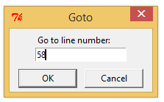
Debugging in Idle
ALT+G or Edit>Go To Line might be useful once you have found the error
But it still isn’t very easy to work with

Slide 32
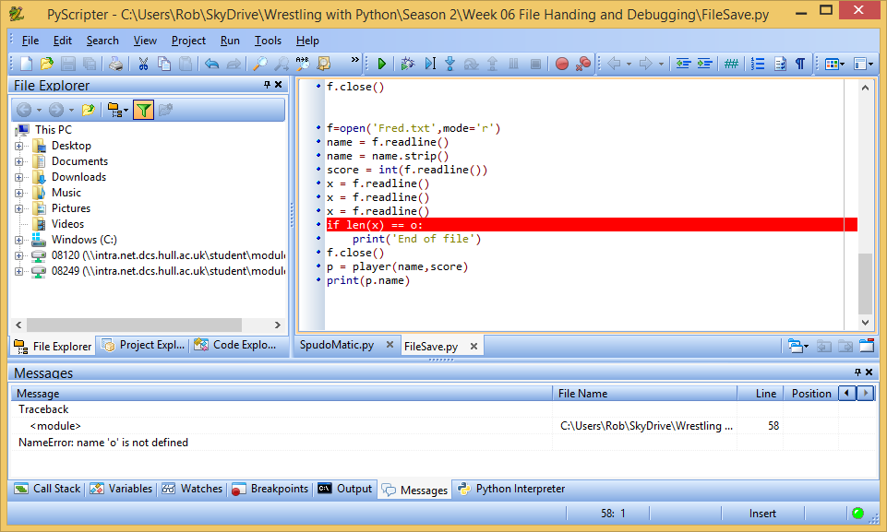
PyScripter

Slide 33
PyScripter and Debugging
PyScripter is a much better way to write Python
Errors are automatically highlighted and it is much easier to find problems
You can also add breakpoints which let you stop your program and investigate the content of variables

Slide 34
Breakpoints
When the program reaches a breakpoint it will pause and let you examine the contents of variables so that you can work out what is going
You can also step through individual statements
This can be very useful for teaching

Slide 35
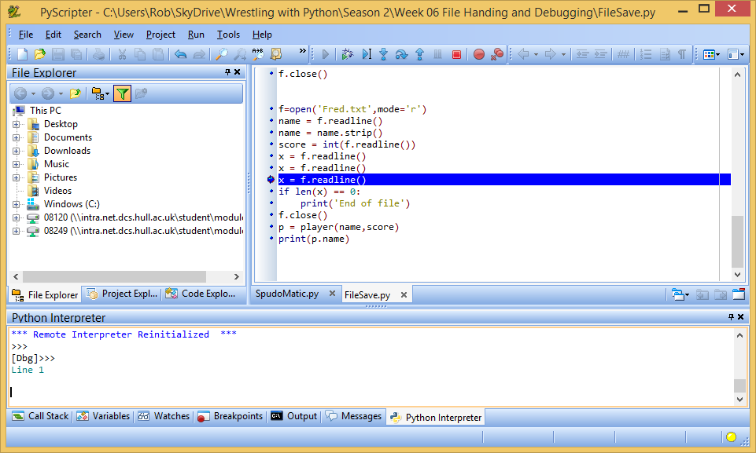
Breakpoints in PyScripter

Slide 36
Getting PyScripter
You can download PyScripter from here:
http://code.google.com/p/pyscripter/
It is only available for Windows devices
There are lots of other Integrated Development Environment (IDE) programs for Python

Slide 37
Practical Break 2
Working with PyScripter

Slide 38
The Art of Programming

Slide 39
Programming Philosophy
You now know enough Python to be able to write useful programs
And dangerous ones
Please be aware that we have taught you the subject from a teaching perspective
There are many ways of viewing the “best” way to write programs

Slide 40
“Python Style”
Any given programming language is designed with a particular programming style in mind
In the case of Python this is a “make it up as we go along and deal with errors as they happen” kind of approach
Which is fine if you know what you are doing
Which of course you don’t know when you start

Slide 41
So….
If people say that what you are doing is not “good Python” they mean that is not in the spirit of “laissez faire” programming
It is perfectly reasonable to respond that you are teaching good programming practice, not conforming to the spirit of any particular language

Slide 42
The Way Forward
Keep writing code and finding new things to do
Look at some of the Python libraries
Strive to enjoy programming
Keep an eye on the web site for new developments

